Slide 1
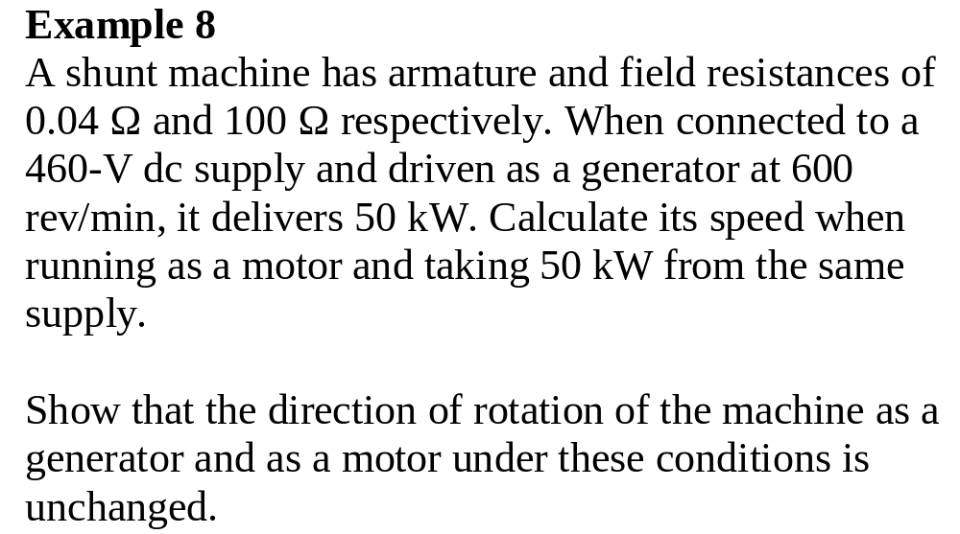

Slide 2
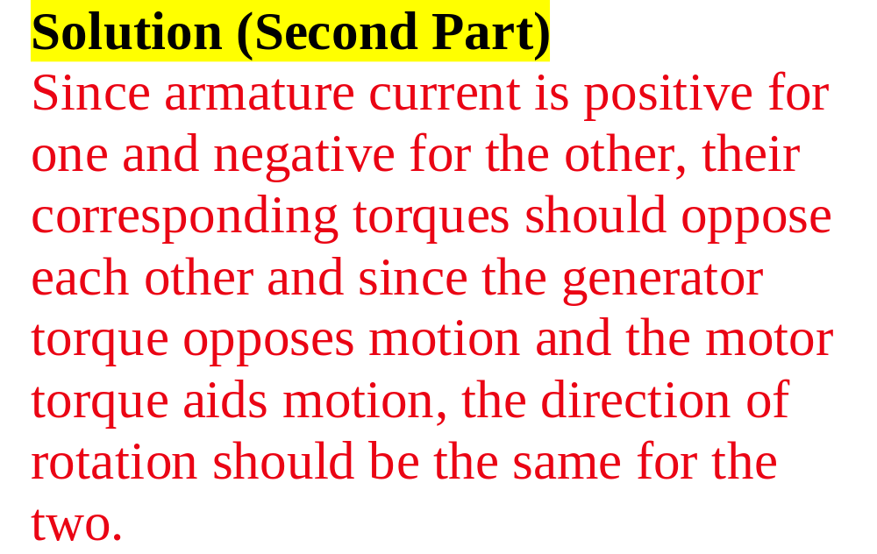

Slide 3
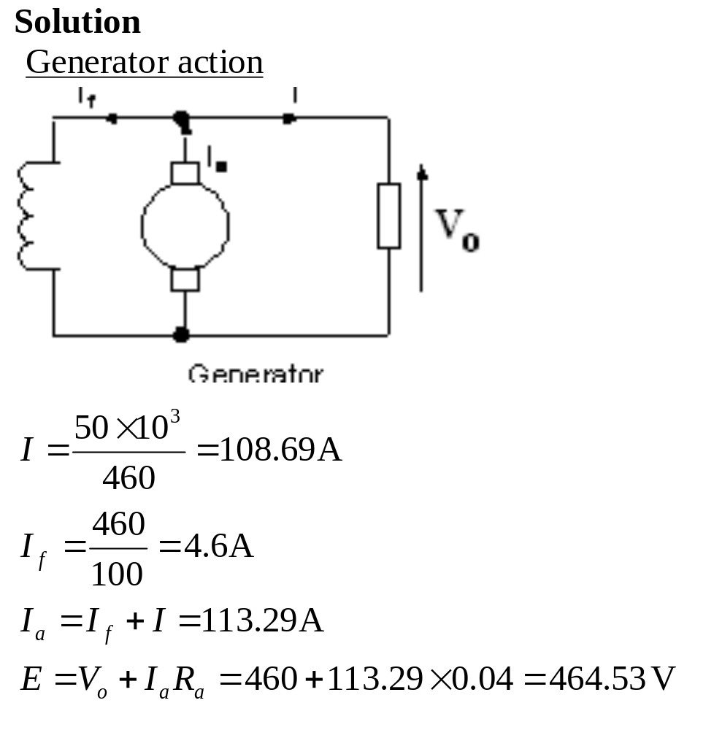

Slide 4
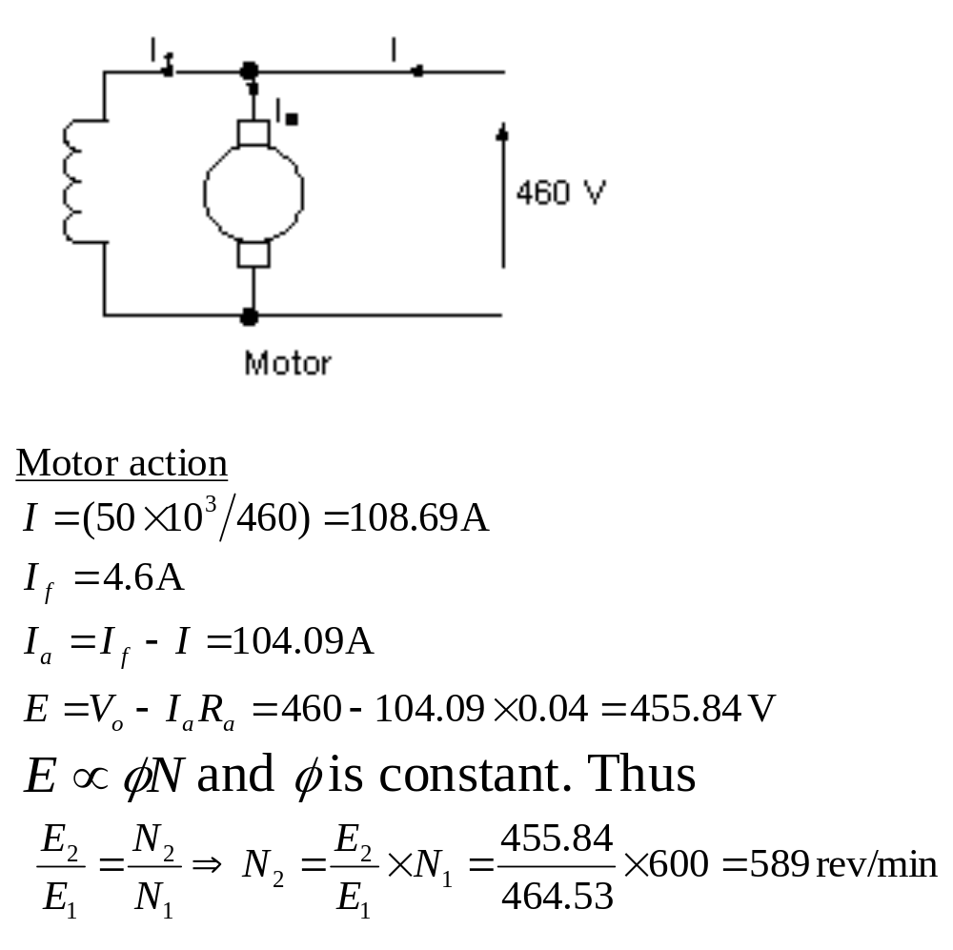

Slide 5
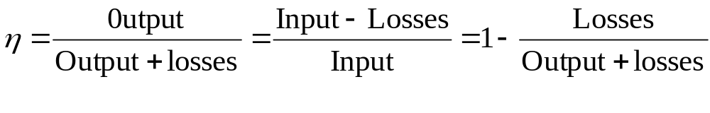
Efficiency of dc machines
The efficiency is calculated using the formula
The power rating of machine corresponds to the useful output power:
  It is electrical if the machine is a generator
  It is mechanical if the machine is a motor.
In rotating machines both mechanical and electrical losses are produced.

Slide 6


Losses in dc machines
Electrical losses: They are composed of
Armature circuit copper loss ( ). R includes all the series connected windings)
Shunt field circuit copper loss ( ). This will include the regulating resistance loss)
Brush contact loss(voltage contact drop x I_{a} ).
The value of the voltage contact drop depends on the type of brush and the pressure applied. When not given the usual value of 2 V is assumed.

Slide 7
Electrical losses cont’d
iron losses: They are produced in the armature core. They are due to hysteresis and eddy current.
Iron losses depend upon flux density, the speed of rotation, the quality of the steel and the size of the armature.
For a given machine, if the speed is constant then the iron loss varies approximately as (flux density)² and hence as the (applied voltage) ².

Slide 8
Electrical losses cont’d
Note that eddy current in the core alternates at a frequency
f = pn_{r}
(n_{r} = speed of machine in rev/sec).
The core is also magnetized at the same frequency by the field.

Slide 9
Mechanical losses
They are due to (i) brush friction, (ii) bearing friction and (iii) windage
The friction losses depend on the design of the bearings, brushes and commutators.
Windage losses depend on the speed, the design of the cooling fan and on the turbulence produced by revolving parts.
For a given machine, the mechanical loss is constant for a constant speed

Slide 10
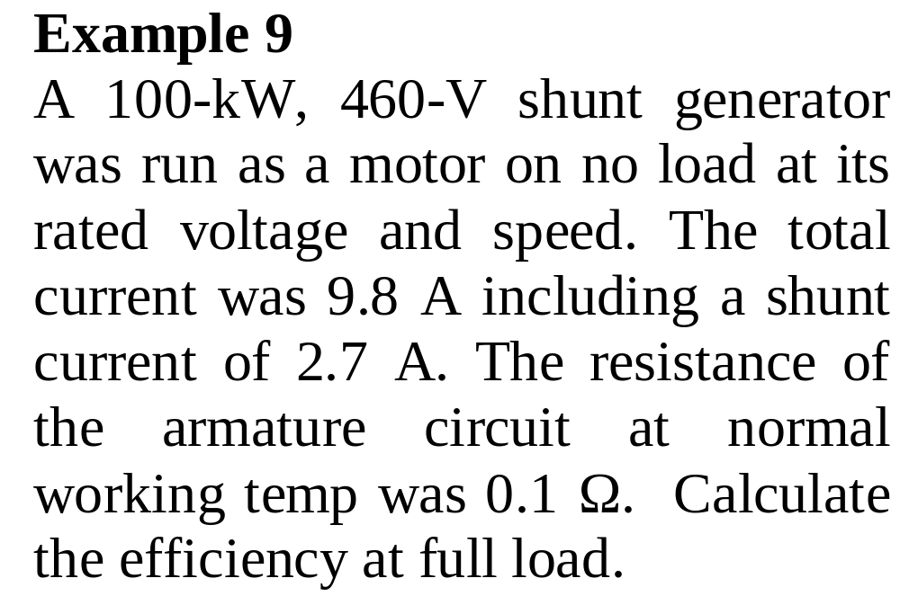

Slide 11
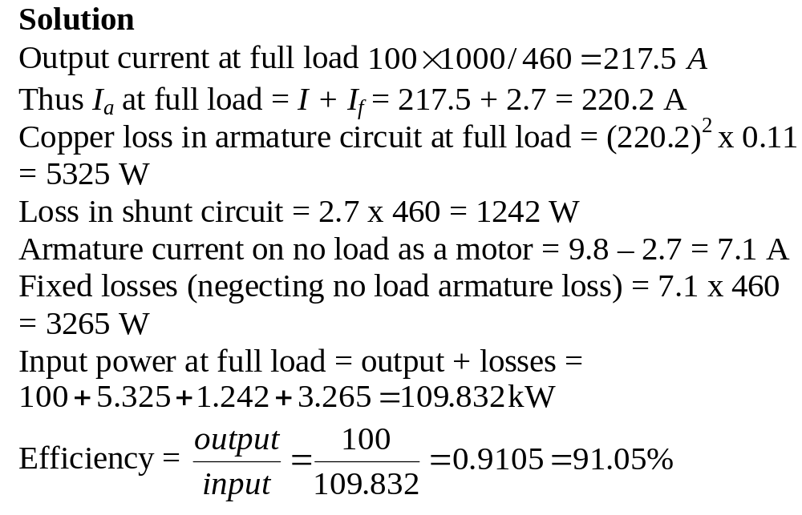

Slide 12
Losses as function of load
As the load on a machine (mechanical, if it is a motor, electrical if it is a generator) increases, the armature current increases. Consequently, the armature circuit and the brush contact loss will rise.
On the other hand, the mechanical and iron losses remain essentially constant as the load increases, unless the speed of the machine changes appreciably.

Slide 13
Losses as function of load cont’d
Since the total losses increase with load and the losses are converted into heat, the temperature of the machine rises progressively as the load increases.
The temperature must not exceed the limiting temperature for the insulation used in the machine.
Consequently, there is a limit to the power which a machine may deliver.

Slide 14
Losses as function of load cont’d
This temperature-limited power gives the nominal or rated power of the machine.
A machine loaded beyond its nominal rating will usually overheat. The insulation deteriorates more rapidly, which inevitably shortens the service life.
If a machine runs intermittently, it can carry heavy overloads without overheating, provided that the operating time is short.

Slide 15
Starting of dc motor
Very small motors are started direct-on-line, i.e., with full voltage applied when stationary to start it
For larger machines the armature resistance is small therefore starting them direct-on-line results in a highly excessive armature current.

Slide 16
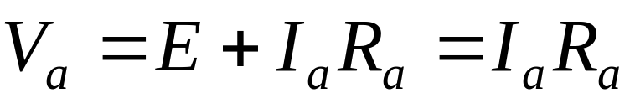
Starting of dc motor cont’d
At starting
because speed is zero and the armature current is limited by only the armature resistance.
Very probable causes of a highly excessive armature current (see next slide):

Slide 17
Armature winding burning out
Damage to the commutator and brushes owing to heavy sparking
Overloading of the feeder
Shaft snapping off due to mechanical shock
Damage to the driven equipment because of the sudden mechanical hammer blow.

Slide 18
Starting of dc motor cont’d
The starting current must initially be limited to 1.5 to 2.5 times the rated current.
If the supply is at constant normal voltage the starting current is limited by connecting resistors in series with the armature.

Slide 19
Starting of dc motor cont’d
A liquid rheostat gives a smooth variation in resistance but robust metallic resistors arranged in series sections that can be cut out successively by manual or automatic operations are usually preferred.
Today, electronic methods are often used to limit the starting current and to provide speed control.

Slide 20
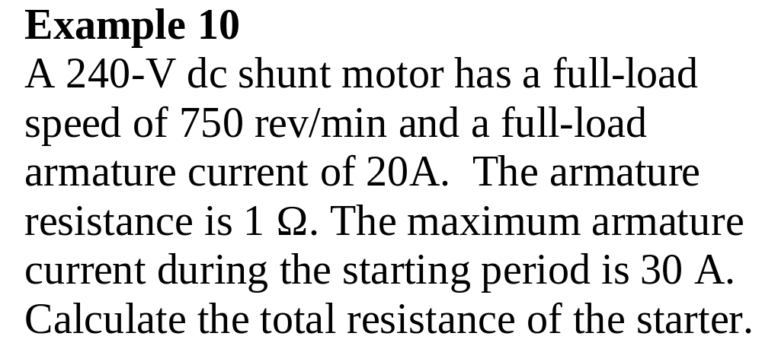

Slide 21
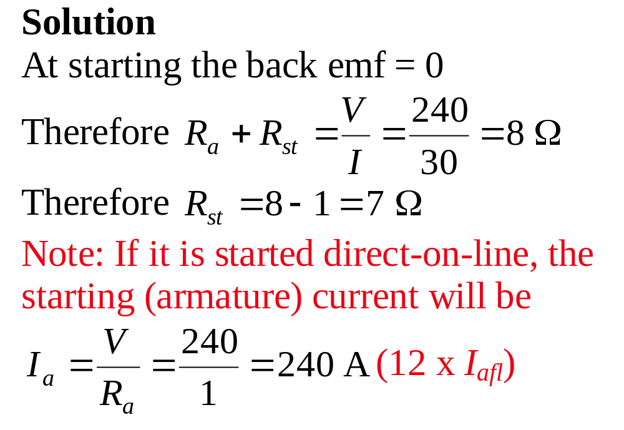

Slide 22
Grading starting resistance for shunt and separately excited motors (constant flux)
In grading the starting resistance we are required to ensure that the starting current varies between specified upper and lower limits I₁ and I₂
The lower limit is necessary to ensure rapid acceleration.

Slide 23
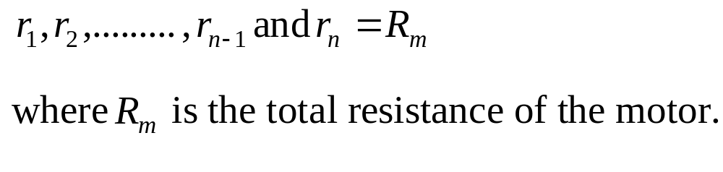
We note the following:
If the starter has (n-1) elements, then the start will be made in n steps by cutting out the sections in sequence
At switch-on (step 1) the total armature-circuit resistance R₁ be made up of n series section:

Slide 24
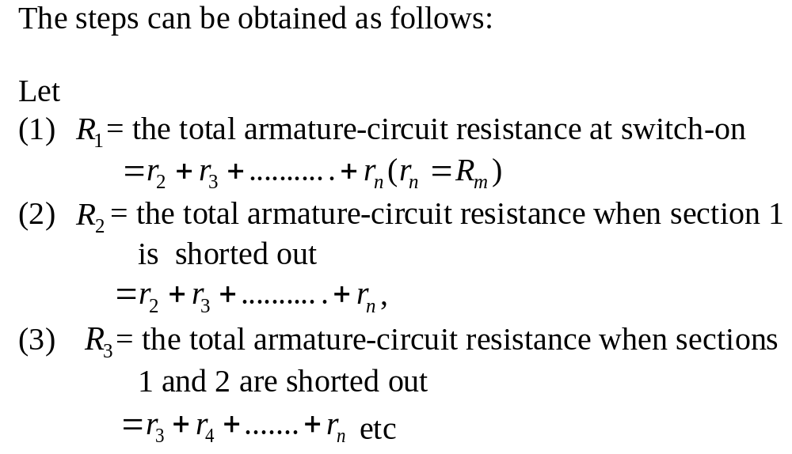

Slide 25
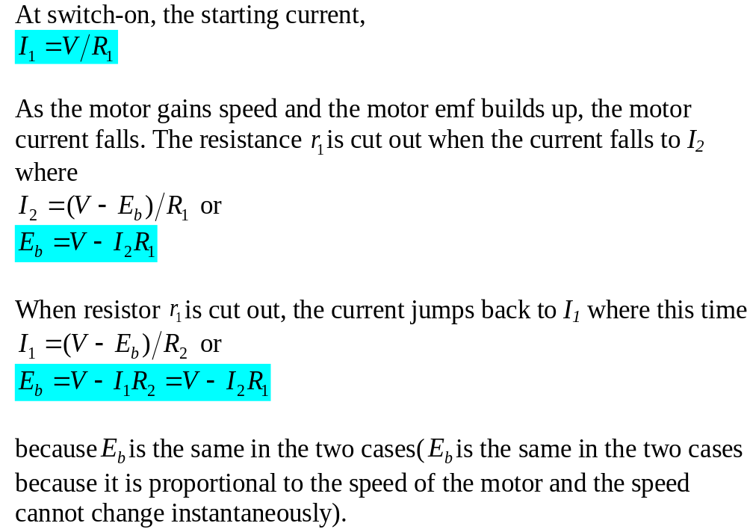

Slide 26
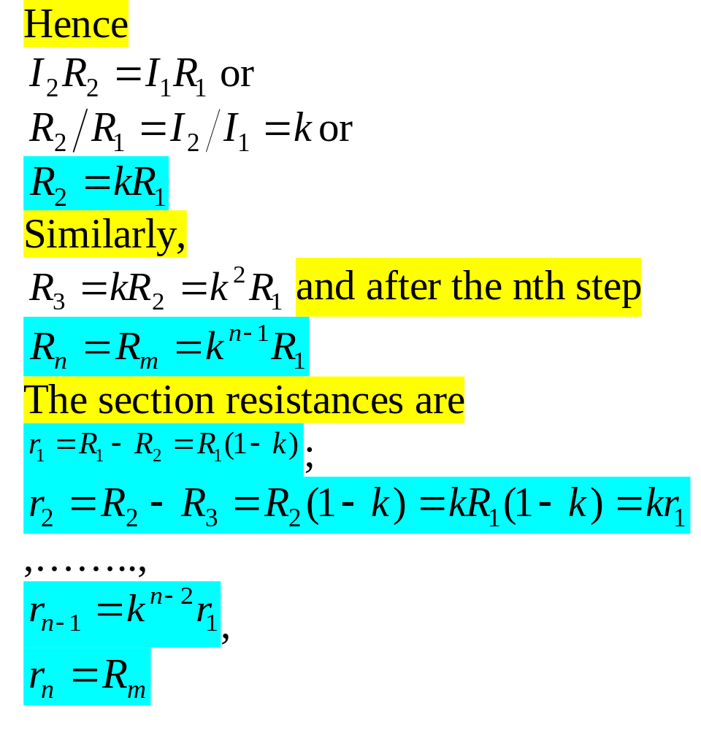

Slide 27
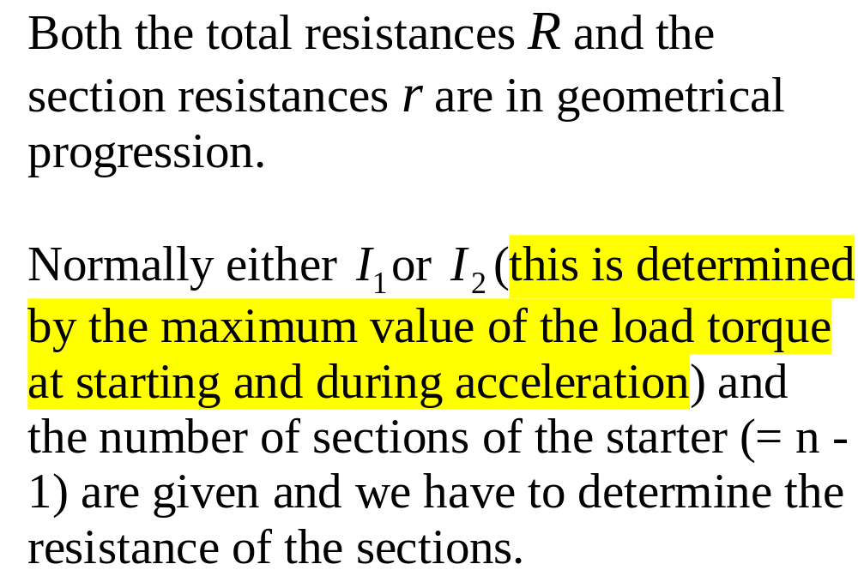

Slide 28
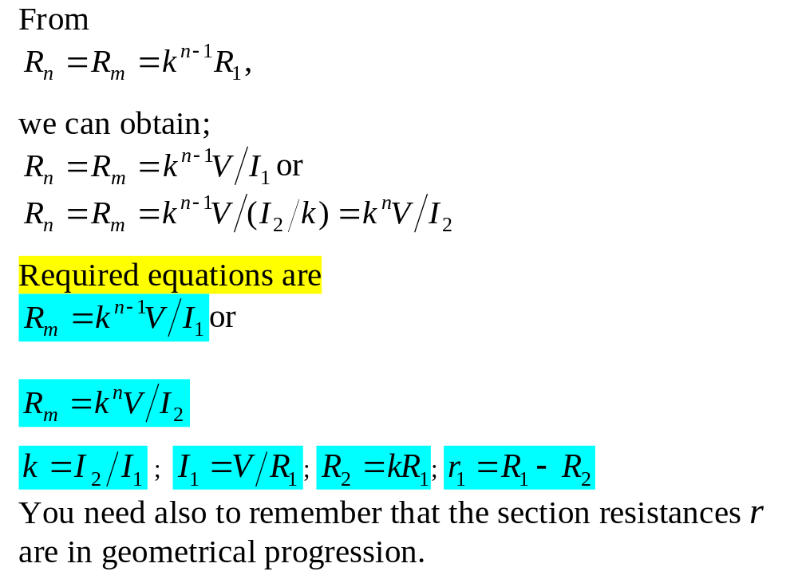

Slide 29
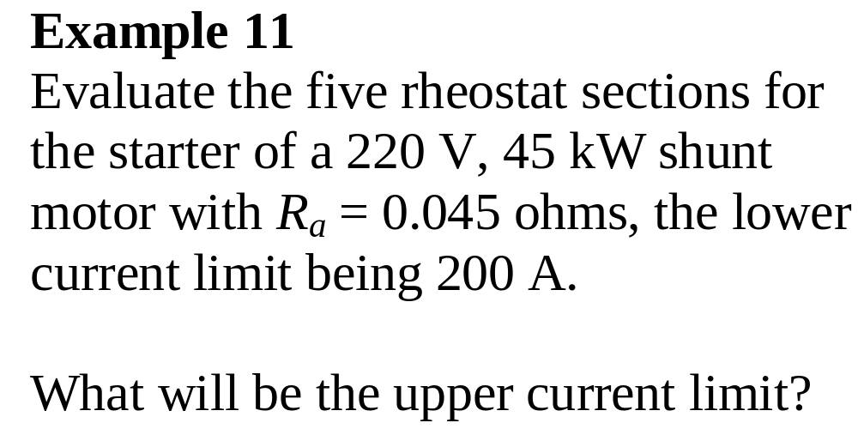

Slide 30
